Slide 1

Exploratory analysis of Big Data and Cloud EDABDC
Preparing and processing data with Azure Data Factory

Slide 2
Types of plots
Data visualization
Trends
Line plot
Relationships
Distribution Plots
Scatter plots
Heat Map
Bar plots
Reg plot

Slide 3
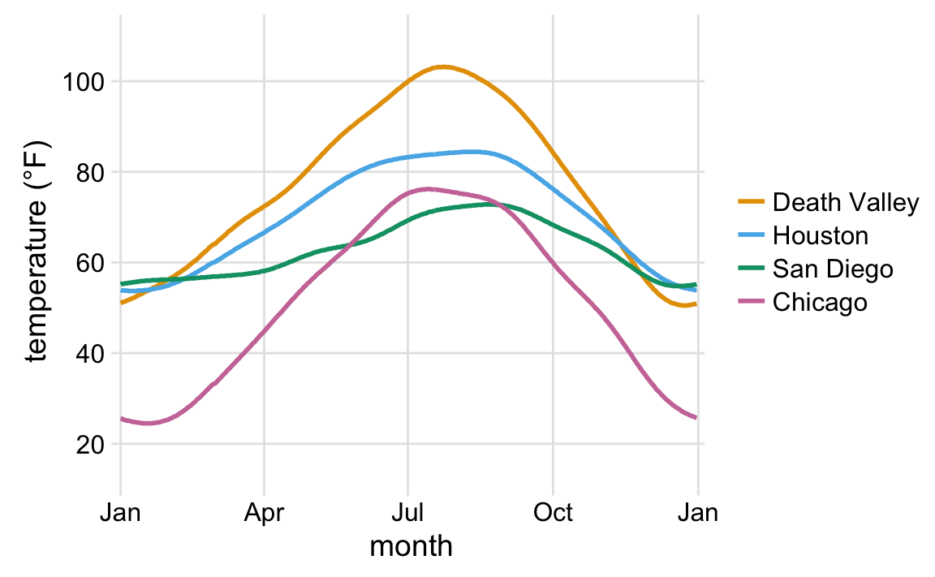
Line plot
Notes:
What do you see here? What’s the story and how do the aesthetics tell it?

Slide 4
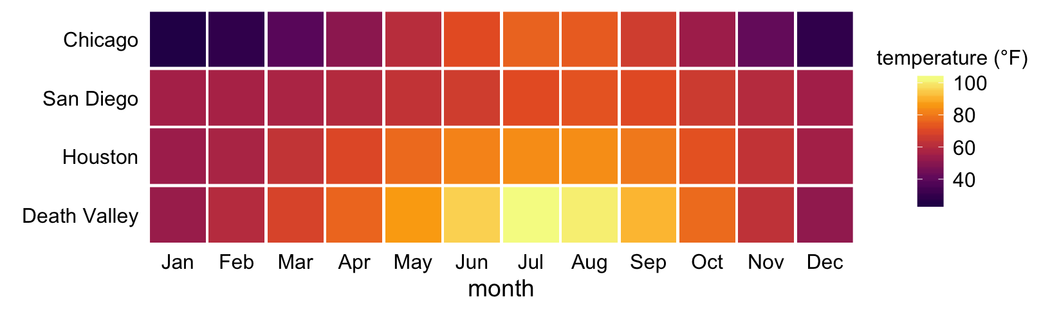
Heat Map
Notes:
This is the same data
What do you see here? What’s the story and how do the aesthetics tell it?

Slide 5
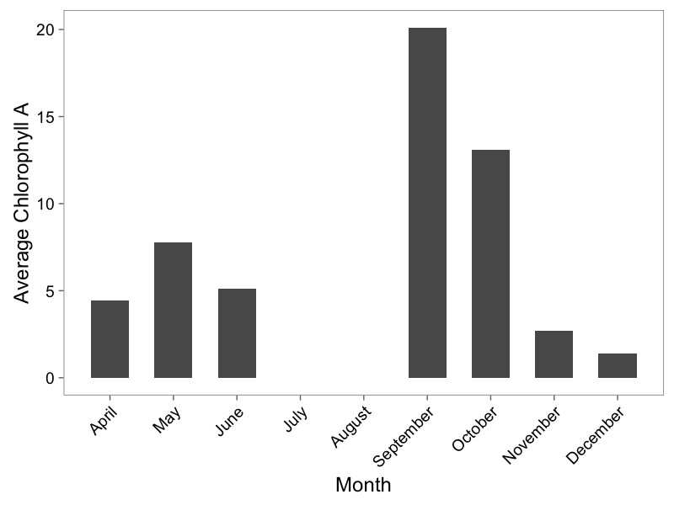
Barplots

Slide 6
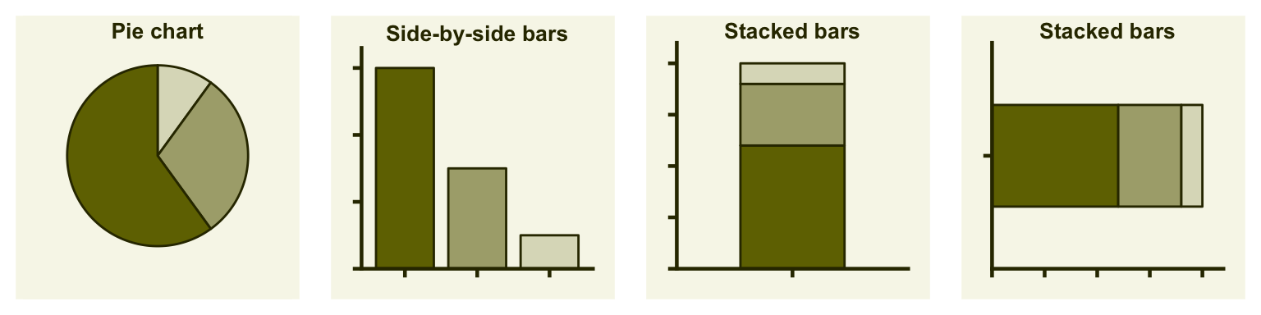
Types of Visualizations: Proportions
Notes:
Costs and benefits of each

Slide 7
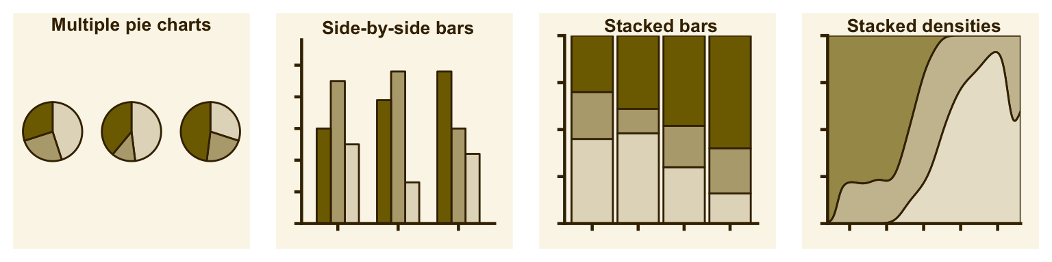
Types of Visualizations: Multiple Proportions
Notes:
Costs and benefits of each

Slide 8
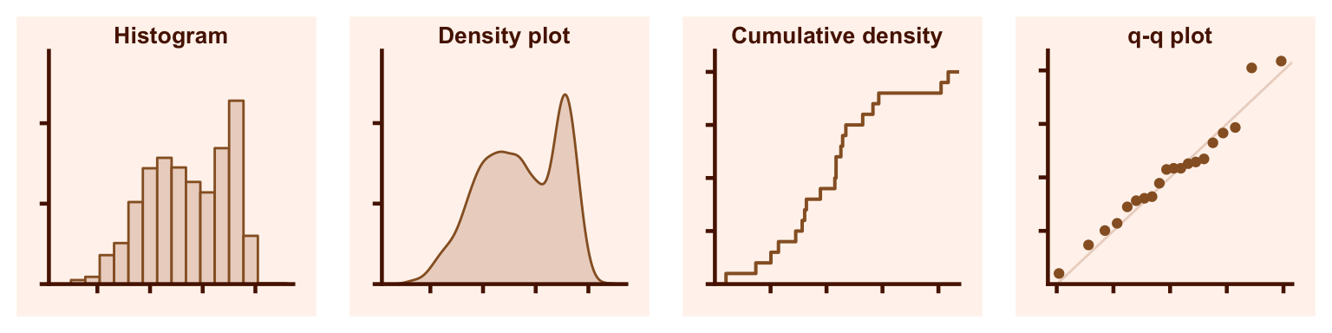
Types of Visualizations: Distributions
Wilke 2018

Slide 9
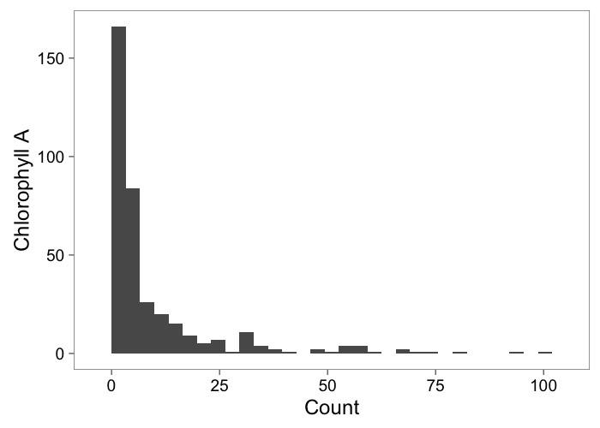
Histograms Show Frequency

Slide 10
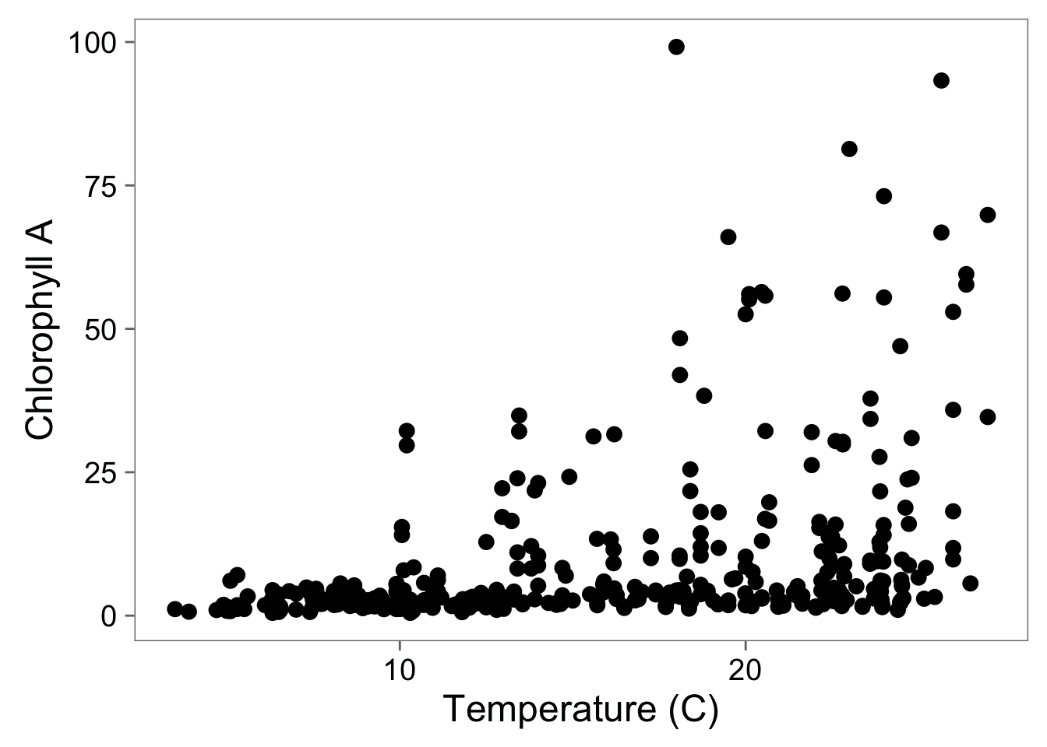
Scatterplots Show Relationships

Slide 11

Colors Can Distinguish Groups

Slide 12
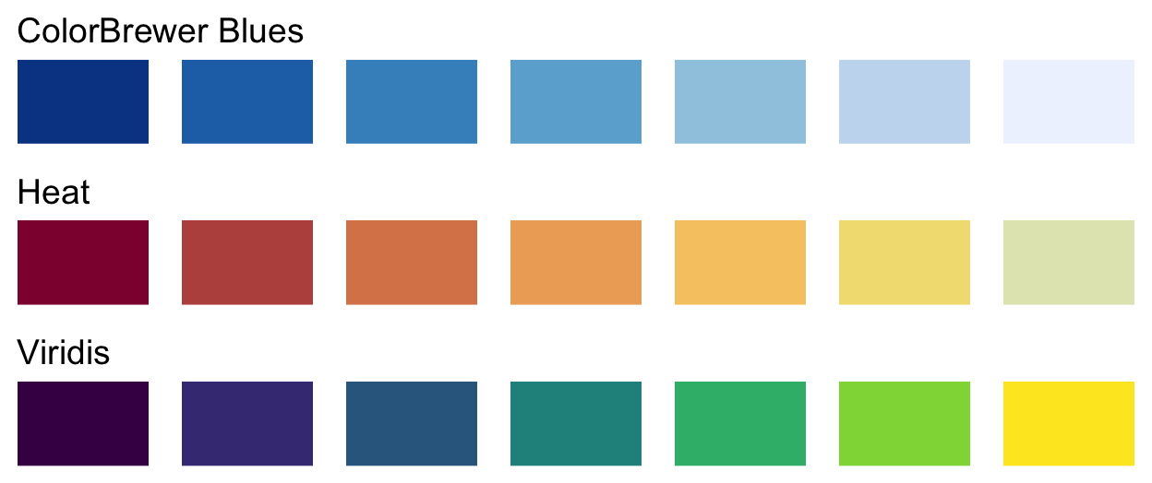
Colors Can Show Data

Slide 13
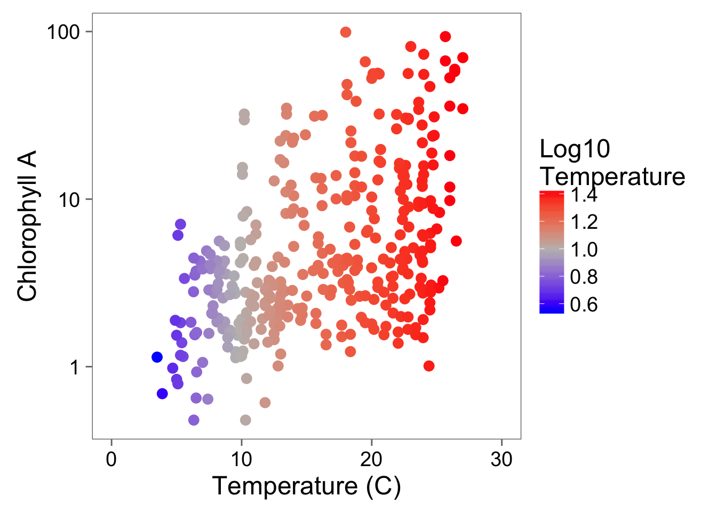
A Touch of Color!

Slide 14
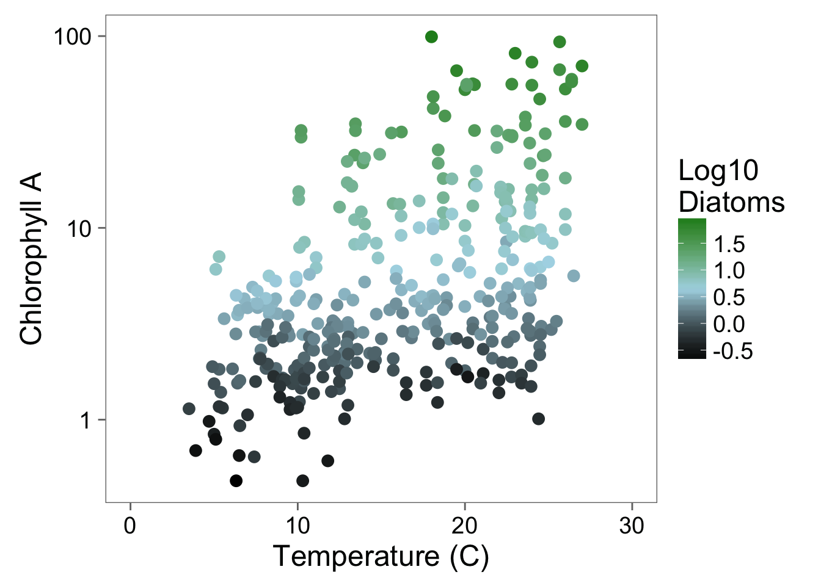
Color Can Bring in Another Dimension

Slide 15
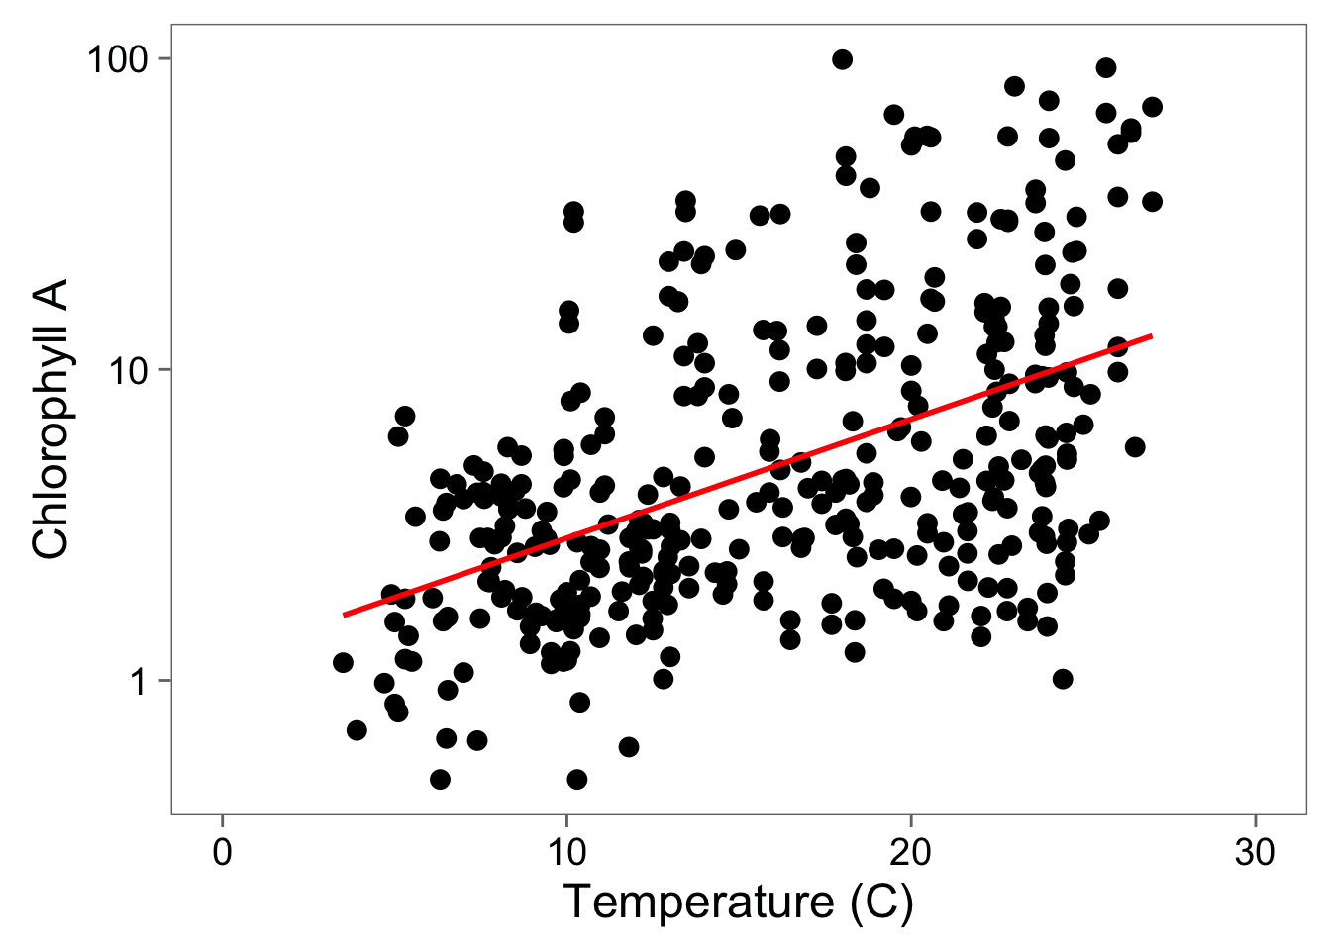
Statistical Fit to Aid Understanding

Slide 16

Questions

